Slide 1


Hello & Welcome
Notes:
Meredith
Maybe ask some of the newer agency staff to introduce themselves: Bair- James Bell, CTS’s new person, Access (if they are on)

Slide 2

Division of Child and Family Wellbeing Initiatives

Slide 3
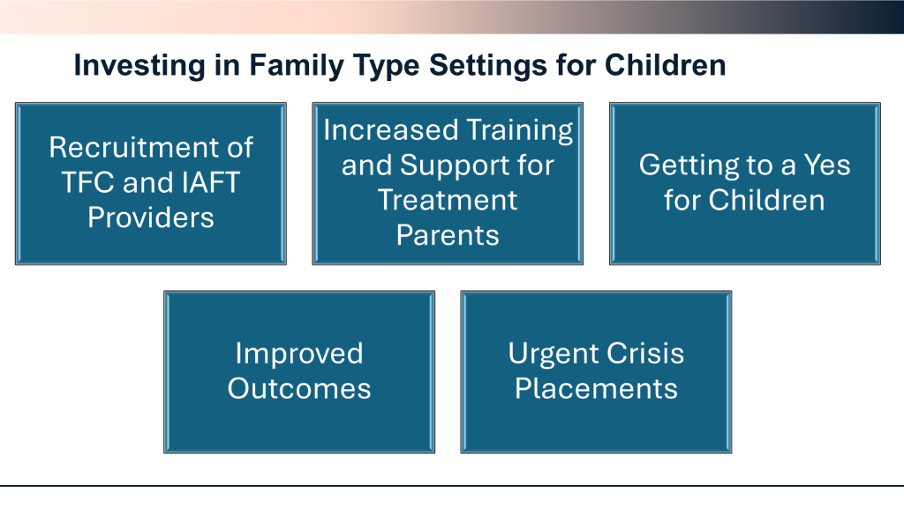
The Goal of the Division of Child and Family Wellbeing

Slide 4
Treatment Parent Specialist Certification
“Sticky Families”
Treatment Foster care struggles to secure placement for high-acuity youth and dually diagnosed consumers. Frequent referral responses state “no” due to high acuity behaviors (property destruction, sexualized behaviors) as the reason for placement denials and inability to match to open homes. RRFF’s creation of the Treatment Parent Specialist Certification (TPSC) program will support an educational training program to provide treatment parents with the enhanced skill set necessary to meet the youth’s needs in the community instead of a residential facility.

Slide 5
Treatment Parent Specialist- IAFT® Provider Network
Expectations
Utilize IAFT homes- minimum 25 across the IAFT network
35 hours training required for certification provided by RRFF
Attestation
QP training 15 hours
Referral Response and Acceptance rate 70% at the home level
Bedboard accuracy and facility profile updated
Guaranteed base daily rate by provider to TP for standardization of initiative
Stabilization and crisis support

Slide 6
Deliverables from TPS Initiatives
Dedicated referral flow in CCW
Additional flat rate monthly for TPS for three months and then reduced rate for remaining months 4-6
QP incentive for months 1,2,3
Agency stipend for stabilization for first three months
Training developed by UNC and RRFF provided cost-free
Reporting metrics for the Division-response and acceptance rate, catchments, los, discharge metrics, youth demographics

Slide 7
Professional Parent Supports
PPS will support therapeutic treatment provider agencies by providing 10-15 hours weekly per youth as needed. The goal is to create a “Village” to provide the treatment parent with additional support, ensure proper supervision, and allow the youth to build additional natural supports within their home community.
Natural Supports and DSS Basic Family Foster

Slide 8
Expectation of PPS- Natural Supports
Background checked
Training 15 hours and attestation
Provide availability schedule
Support Treatment Parent Specialists and Interim Stay Parents
Expectation of PPS- DSS Basic Family Foster
Training 15 hours and attestation
Provide availability schedule
Support Treatment Parent Specialist and Interim Stay Parents

Slide 9
Deliverables of PPS- Natural Supports and DSS BFF
Training provided by RRFF
Tracking of PPS availability in CCW
Compensation for natural supports up to 15 hours weekly
Compensation for BFF up to 15 hours weekly
Agency compensation for background checks and admin

Slide 10
Urgent Crisis Placement
Interim Stay Parents
14-21 Day- Interim Stay Parent Placement to support youth in DSS offices & Hospital Eds
Currently, youth are in DSS offices and hospitals waiting for placement at the appropriate level of care. One solution is for existing Child Placing Agencies (IAFT®) to identify 50 homes to serve as Interim Stay Family Placements for short-term emergencies. At the same time, efforts to ensure a clinical assessment and recommendation, along with supportive documentation, are gathered by the provider, guardian, and care manager. The Interim Stay Parent is to receive enhanced supervision and crisis response while the youth is in a community setting.

Slide 11
Expectations of Interim Stay Parents
Provider identify dedicated homes (2)
Participate in 15 hours training
Attestation
Work with providers to assist with link to recommended level of care
Acceptance rate at the home level
Respond to referrals

Slide 12
Deliverables of Interim Stay Parents Initiative
Homes will be identified in CCW with availability
15 hours of training provided by RRFF
Dedicated referral flow process for these high-acuity youth
Provider transitions to another level of care referral in the database
Interim Stay Parents are compensated with flat rate for 14-21 day placement on top of billable service
Barrier removal compensation example. Daycare, transportation cost
Provider agency flat fee per youth for crisis response/supervision referrals
QP incentive per youth

Slide 13
PRTF to IAFT® Pilot Ongoing
Too many youths with co-occurring diagnoses, autism, sexually inappropriate behaviors, and aggression are not matched with current “viable” placements. RRFF has found success with a Pilot program sponsored by The Duke Endowment that focuses on the partnerships between providers, PRTF, MCO Care Managers, and guardians through a pilot built on intentionality and relationship building. The focus is on 6-8 preplacement matching before discharge to support stabilization and retention of the youth upon discharge and alignment with the identified permanency plan.

Slide 14
Expectations of Pilot
Improve acceptance rate
Engage in pre-placement scope of work and documentation
Participate in IAFT®
Fidelity training
Maintain stabilization and retention
Focus on shared parenting
Deliverables of PRTF to IAFT ® Pilot
Training support
Compensation to Treatment Parent for 4-month stabilization rate
Compensation to provider agency for stabilization at the end of 4 months
Compensation to QP for stabilization support at end of 4 months

Slide 15
What we need from you
Maintain your bedboards in CCW
Remind everyone to put the referrals in CCW so you don’t have to
Respond promptly to referrals (Yes, no, maybe)
Connect with your PRTF referal sources to review the referral process for youth stepping down from PRTF (especially out of state youth) to participate in PRTF-IAFT Pilot 6-8 weeks in advance
Share RRFF training platform which is instructor-led, virtual, free, and open to everyone https://ncrapidresource.org/training-tools-resources/calendars/ and Level of Care self-paced training https://ncrapidresource.org/self-paced-courses/residential-service-lines-and-the-continuum-of-care/
Contact:
Meredith Newman mnewman@ncrapidresource.org or Rashel Lauret rlauret@ncrapidresource.org

Slide 16

PRTF to IAFT® PILOT
18 youth placed (3) working pre-placement activities
15 of these youth have well surpassed 90 days and showed stabilization in the IAFT® home.

Slide 17

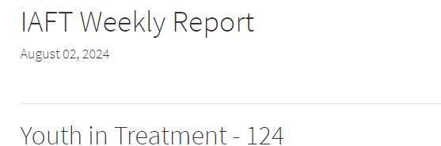
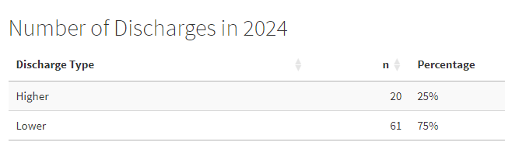
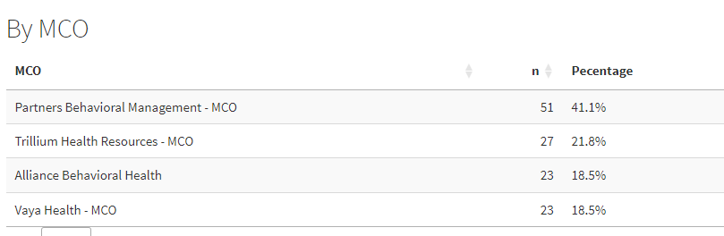
IAFT Snapshot
Decrease in placements and acceptance of IAFT youth
Currently # of open IAFT referrals seeking placement match
Currently # of open IAFT beds across the state reflected on Bedboard
Discharge outcomes remain steady at (3) out of (4) youth stepping down in level of care

Slide 18

Trainings open to all Agency & Parents
August Topics
Dealing with Sneaky Behaviors- Handling Stealing/Lying
How to Secure All Firearms Effectively in Your Home
Embracing Cultural Differences in Foster Care
Beneficial Tools to Maintain Stable Placements
Understanding Sexualized Behaviors of School-Age Youth
Food Hoarding: What’s Behind the Behavior?
Resource Parent Curriculum Group (open to all)
Tuesdays Sept 10th- Oct 29th 6pm-8pm virtual
“ I was thinking about not fostering anymore, but after taking RPC I think I will reconsider and at least try respite”.
“I’m going to be more patient with my next child”
“I’m so glad that I took this training” “I really enjoyed the class”
“I liked the fact that there are other parents out here that were feeling the same way that I was, so now I don’t feel so bad”.
Notes:
Shevon

Slide 19

IAFT® Clinicians –Ethics CEU opportunity
RRFF has partnered with Eastern AHEC to offer free online access to (2) approved hours of Ethics training.
RRFF will be reaching out for a list of names/email addresses for interested parties.
Course will be open August to October of 2024.

Slide 20
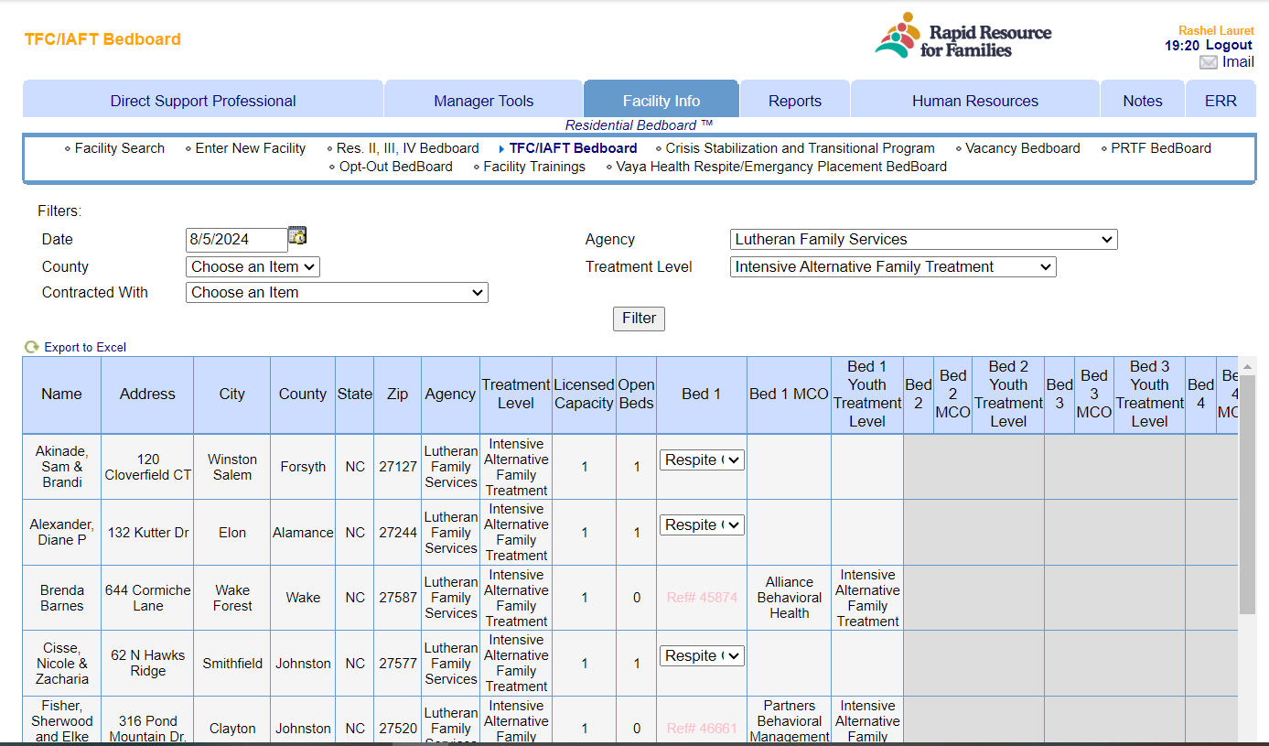
IAFT/TFC Residential Bedboard™ Capacity updates
RRFF Staff have updated most IAFT homes to a capacity of (1) to reflect accurate “vacancies”. If the home has a 2nd bed open for Respite- you can still use that bed and reflect on the AC. If an approved 1+ waiver is utilized then the capacity can be changed to (2) to reflect.

Slide 21

Q2 Quarterly Reviews
168 youth received IAFT® Services
Average Overall Provider Score: 94%
Positive Trends
Areas for Growth
Overall improvement noted in documentation of active discharge & permanency planning
Treatment Parent Supervision reflects a high level of coaching and support utilizing agency evidenced based models
Data is being entered in CCW more consistently
Treatment Parent Grid Notes continue to reflect minimal active, goal-driven interventions and are overall a narrative of the youth behaviors for the day
Minimal documentation of follow through on recommendations from SV or Psychiatric Provider and support provided after a crisis incident or when disruption potential has been identified.
Notes:
Kathy

Slide 22
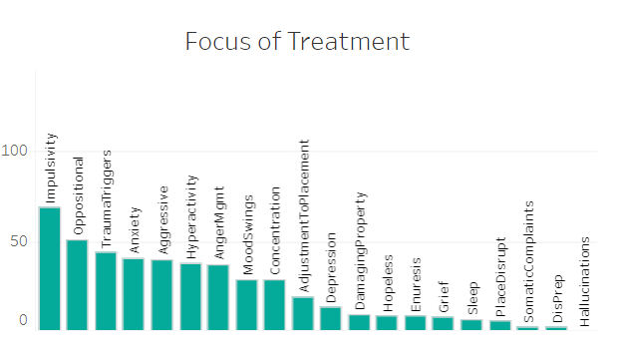
Focus Area: Psychiatric Oversight
As of 7/10/24, 99% of the youth in placement for the entire month had an entry in CCW!
Notes:
Michael

Slide 23
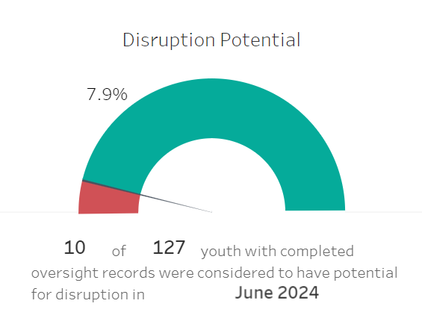
Disruption Potential
We ask that you thoughtfully consider and indicate if the youth is currently at risk for disruption (defined as a higher level of care or lateral move). We will be removing "N/A" as an option from the template in CCW. If "yes", please select factors that are contributing to placement instability and indicate protective steps to stabilize placement.
Contributing Factors
Youth Behavior
Youth-Treatment Parent Relationship
Treatment Parent Skills / Stress
Family of Permanence Issues
Notes:
Michael

Slide 24
Coming Up...
Quarterly Quality Fidelity Reviews:
  The Program Integrity Team is slowly implementing a new method of monitoring model fidelity, with a higher focus on quality and staff understanding of the IAFT® elements.
  We want to give a HUGE Shout Out to Integrated Family Services for being the first to participate in our beta test of the QQFR and doing an excellent job!
Focused Spot-Checks on Daily Behavior Checklists
  Do targeted behaviors match the PCP?
  Is there fluctuation of scores throughout the quarter?
Consultant Assignment Updates
  Michael: CHA, CTS, Rapha, Bair, Lutheran, Turning Point, and Kids Peace
  Karen: AYN, Support, ES/UCP, Omni, Clarvida-AFS, Integrated
  Kathy: Overall network support, growth, and initiatives
Notes:
Pit Crew – Karen

Slide 25

Questions, comments share your exciting news!

